Slide 1


Computer Science: An Overview
Twelfth Edition
Chapter 1
Data Storage
Yu Yang
School of Computer Science,
Pingdingshan University,
yangyu@pdsu.edu.cn
Notes:
If this PowerPoint presentation contains mathematical equations, you may need to check that your computer has the following installed:
1) MathType Plugin
2) Math Player (free versions available)
3) NVDA Reader (free versions available)

Slide 2
Learning Objectives (1 of 2)
1.1 Bits and Their Storage（位和位存储）
1.2 Main Memory（主存储器）
1.3 Mass Storage（海量存储器）
1.4 Representing（表示） Information as Bit Patterns（模式）
1.5 The Binary System（二进制系统）

Slide 3
Learning Objectives (2 of 2)
1.6 Storing Integers（整数存储）
1.7 Storing Fractions（分数）
1.8 Data and Programming（数据和程序设计）
1.9 Data Compression（数据压缩）
1.10 Communications Errors（通讯误差）

Slide 4
Bits and Bit Patterns
Bit: Binary Digit (0 or 1)
Bit Patterns are used to represent information
Numbers
Text characters（性格，计算机里表示字符）
Images（想像，计算机里表图片）
Sound
And others

Slide 5
Boolean Operations（操作运算）
Boolean Operation: An operation that manipulates（操作，操纵） one or more true/false values
Specific operations（具体操作）
AND （与）
OR （或）
X OR (exclusive or)（异或）
NOT （非）

Slide 6
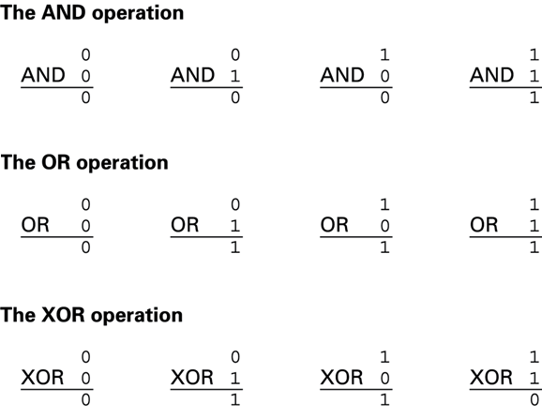
Figure 1.1 The Possible Input and Output Values of Boolean Operations AND, OR, and XO R (exclusive or)

Slide 7
Gates（门，隔开）
Gate: A device that computes a Boolean operation（运算）
Often implemented（部署，实现） as (small) electronic circuits（电路）
Provide the building blocks（块，构件） from which computers are constructed 为构造计算机提供了构件
V L S I (Very Large Scale Integration)（超大规模集成将数百万个电子元件构造在一个chip芯片上，从而构造出包含数百万个触发器及其控制电路的微型设备）

Slide 8
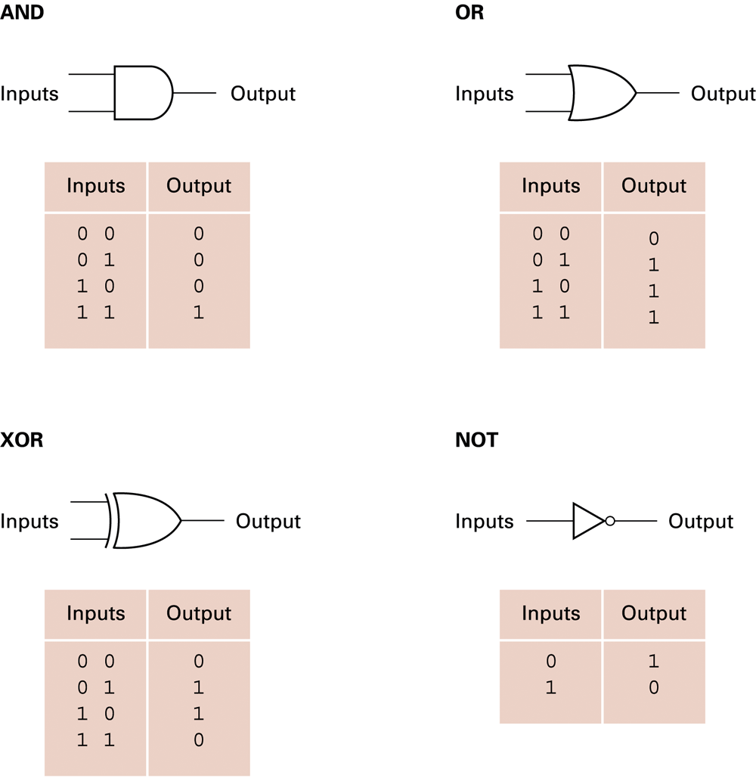
Figure 1.2 A Pictorial（图片） Representation of AND, OR, X OR, and NOT Gates as Well as Their Input and Output Values

Slide 9
Flip-Flops（触发器，人字拖，反复）
Flip-flop: A circuit built from gates that can store one bit.（存储一个位）
One input line is used to set its stored value to 1
One input line is used to set its stored value to 0
While both input lines are 0, the most recently stored value is preserved（保存）

Slide 10
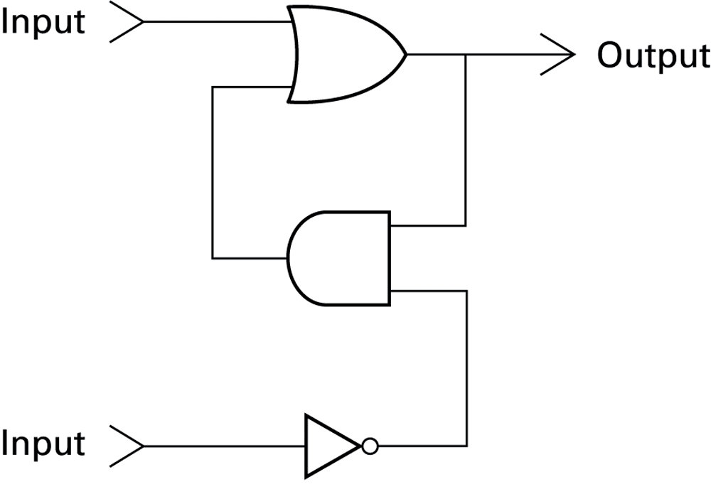
Figure 1.3 A Simple Flip-Flop Circuit

Slide 11
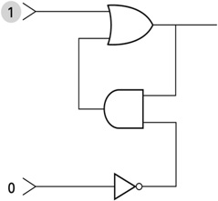
Figure 1.4 Setting the Output of a Flip-Flop to 1 (1 of 3)（输出值设置为1）
a. First, 1 is placed on the upper input.

Slide 12
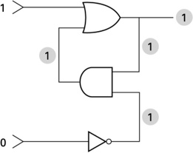
Figure 1.4 Setting the Output of a Flip-Flop to 1 (2 of 3)
b. This causes the output of the OR gate to be 1 and, in turn（继而）, the output of the AND gate to be 1.

Slide 13
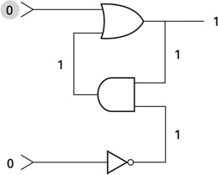
Figure 1.4 Setting the Output of a Flip-Flop to 1 (3 of 3)
c. Finally, the 1 from the AND gate keeps the OR gate from changing after the upper input returns to 0.

Slide 14
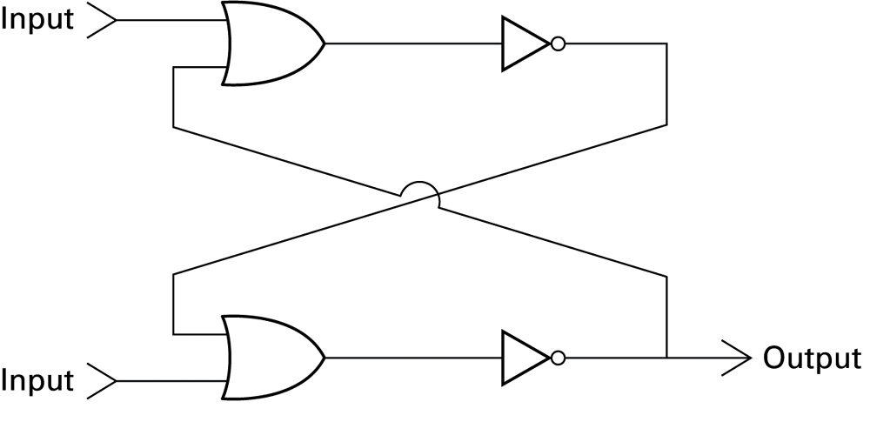
Figure 1.5 Another Way of Constructing a Flip-Flop（与1.3的功能一样）

Slide 15
Hexadecimal Notation（十六进制符号）
Hexadecimal notation: A shorthand（速记） notation for long bit patterns
Divides a pattern into groups of four bits each
Represents each group by a single symbol
Example: 10100011 becomes A3

Slide 16
Figure 1.6 The Hexadecimal Coding System
Bit pattern | Hexadecimal representation
0000 | 0
0001 | 1
0010 | 2
0011 | 3
0100 | 4
0101 | 5
0110 | 6
0111 | 7
1000 | 8
1001 | 9
1010 | A
1011 | B
1100 | C
1101 | D
1110 | E
1111 | F

Slide 17
Main Memory Cells（单元）
Cell: A unit of main memory (typically 8 bits which is one byte)
Most significant（最高有效） bit: the bit at the left (high-order，高位) end of the conceptual row of bits in a memory cell
Least significant bit: the bit at the right (low-order) end of the conceptual row of bits in a memory cell

Slide 18
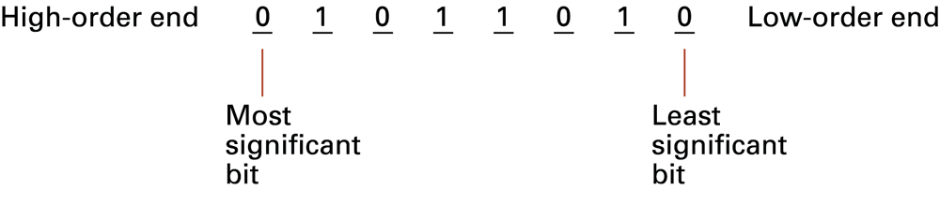
Figure 1.7 The Organization of a Byte-Size（字节模式） Memory Cell

Slide 19
Main Memory Addresses
Address: A “name” that uniquely identifies（唯一标识） one cell in the computer’s main memory
The names are actually numbers.
These numbers are assigned consecutively（连续的） starting at zero.
Numbering the cells（单元） in this manner associates（赋予，关联） an order with the memory cells.

Slide 20
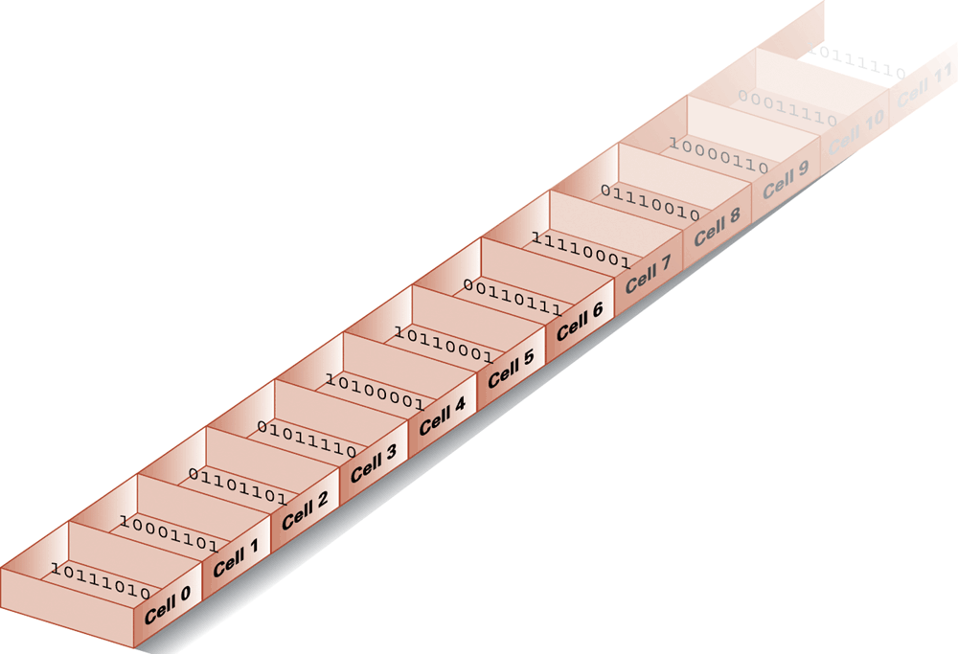
Figure 1.8 Memory Cells Arranged（排列） by Address

Slide 21
Memory Terminology（术语）
Random Access Memory (R A M): Memory in which individual cells can be easily accessed in any order
Dynamic Memory (D R A M): R A M composed of volatile（易挥发的，不稳定的，易消散的） memory，2016年后，笔记本电脑都以DD4存储器取代DDR3 L存储器

Slide 22
Measuring（度量） Memory Capacity
Kilobyte:
bytes = 1024 bytes
Example: 3 K B = 3 times1024 bytes
Megabyte:
bytes = 1,048,576 bytes
Example: 3 M B = 3 times 1,048,576 bytes
Gigabyte:
bytes = 1,073,741,824 bytes
Example: 3 G B = 3 times 1,073,741,824 bytes

Slide 23
Mass（大容量） Storage
Additional devices（附加设备）
Magnetic disks
C Ds
D V Ds
Magnetic tape
Flash drives（闪存驱动器）
Solid-state disks
Advantages over main memory
Less volatility（ [ˌvɒləˈtɪlɪti] ，不稳定性）
Larger storage capacities
Low cost
In many cases can be removed

Slide 24
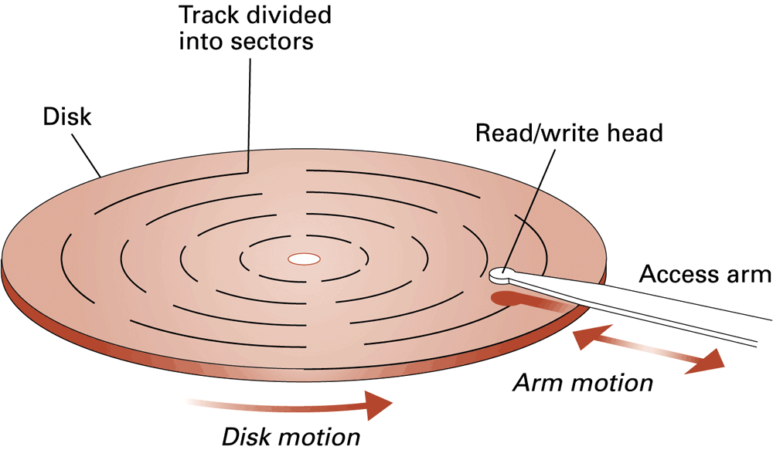
Figure 1.9 A Magnetic（磁性的） Disk Storage System
Track 轨道，磁道 sector 扇区
磁技术
Motion 运动

Slide 25
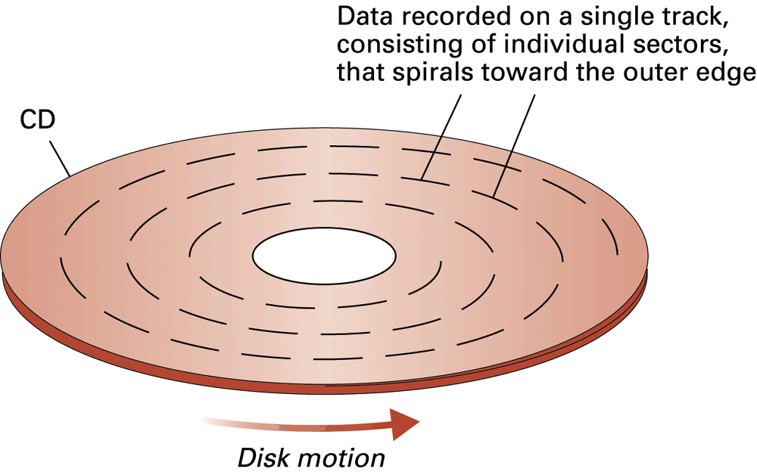
Figure 1.10 C D Storage（compact disk光盘）
光技术
数据存储在分为若干扇区的次倒上，磁道由内向往螺旋形旋转

Slide 26
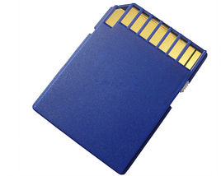
Flash Drives（闪存驱动器）
Flash Memory – circuits that traps electrons（捕获电子） in tiny silicon dioxide chambers（微小的二氧化硅晶格）
电子信号使得该介质中二氧化硅的微小晶格截获电子
Repeated erasing slowly damages the media
Mass storage of choice for:
Digital cameras
Smartphones
S D Cards provide G Bs of storage（Secure Digital Memory Card/SD card ）松下电器、东芝和SanDisk联合推出

Slide 27
Representing（表示） Text
Each character (letter, punctuation, etc.) is assigned a unique bit pattern.
A S C I I: Uses patterns of 7-bits to represent most symbols used in written English text
I S O developed a number of 8 bit extensions to A S C I I, each designed to accommodate（ əˈkɑːmədeɪt 容纳） a major language group 主要语种
Unicode: Uses patterns up to 21-bits to represent the symbols used in languages world wide, 16-bits for world’s commonly used languages

Slide 28
Figure 1.11 The Message “Hello.” in A S C I I or U T F-8 Encoding

Slide 29
Representing Numeric Values
Binary notation（二进制记数法）: Uses bits to represent a number in base two
Limitations of computer representations of numeric values
Overflow: occurs when a value is too big to be represented
Truncation（ trʌŋˈkeɪʃn 截取）: occurs when a value cannot be represented accurately

Slide 30
Representing Images
Bit map techniques（位图技术）
Pixel: short for “picture element”（像素）
R G B（编码）
Luminance（ luːmɪnəns 亮度） and chrominance（ ˈkroʊmənəns 色度）
Vector techniques（矢量技术）
Scalable（可扩展，可放缩）
TrueType（微软和苹果） and PostScript（Adobe 公司）

Slide 31
Representing Sound
Sampling techniques
Used for high quality recordings
Records actual audio
M I D I（乐器数字化接口）
Used in music synthesizers（sɪnθəsaɪzə(r)音箱合成器）
Records “musical score”（记录乐谱）

Slide 32
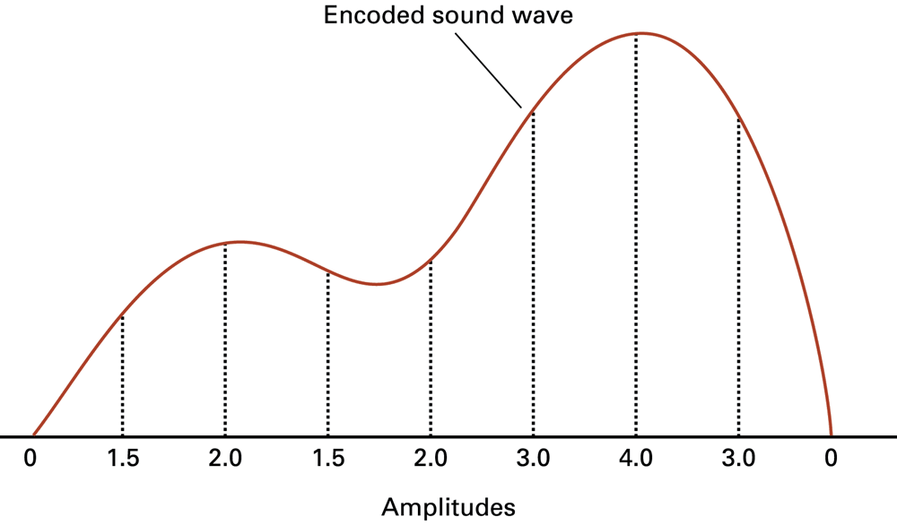
Figure 1.12 The Sound Wave Represented（所表示的声波） by the Sequence 0, 1.5, 2.0, 1.5, 2.0, 3.0, 4.0, 3.0, 0
Amplitude [ˈæmplɪtuːd]振幅

Slide 33
The Binary System
The traditional decimal system is based on powers of ten.
The Binary system is based on powers of two.

Slide 34
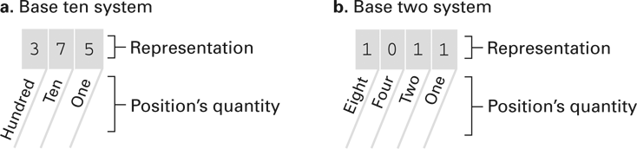
Figure 1.13 The Base Ten and Binary（十进制和二进制系统） Systems
位置的量值

Slide 35
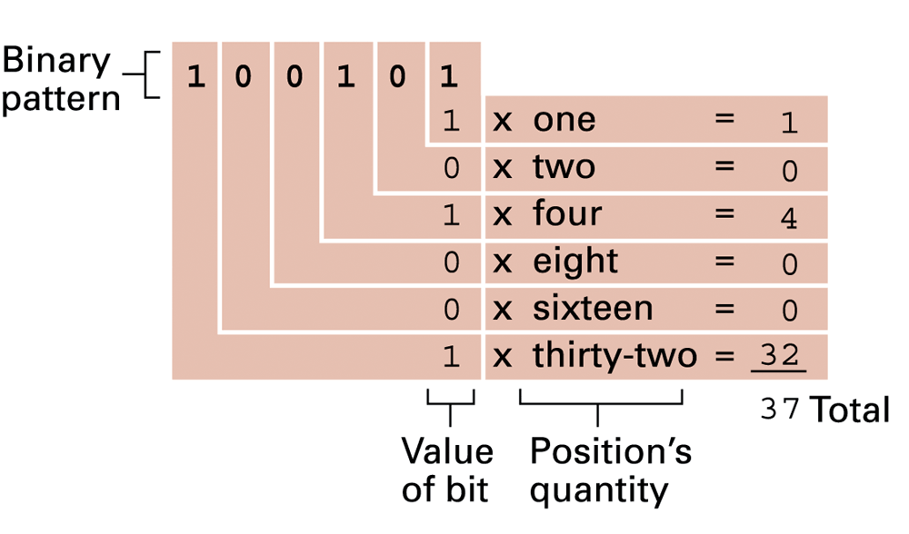
Figure 1.14 Decoding the Binary Representation 100101

Slide 36
Figure 1.15 An Algorithm for Finding the Binary Representation of a Positive Integer
Step 1. Divide the value by two and record the remainder.
Step 2. As long as the quotient ([ˈkwəʊʃnt] 商)obtained is not zero, continue to divide the newest quotient by two and record the remainder（ [rɪˈmeɪndə(r)] 余数）.
Step 3. Now that a quotient of zero has been obtained, the binary representation of the original value consists of the remainders listed from right to left in the order they were recorded.

Slide 37
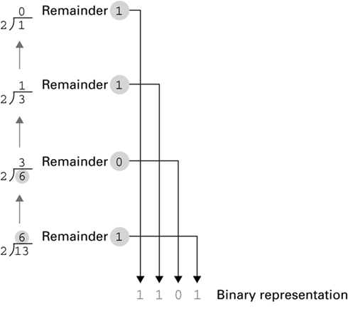
Figure 1.16 Applying the Algorithm in Figure 1.15 To Obtain the Binary Representation of Thirteen

Slide 38
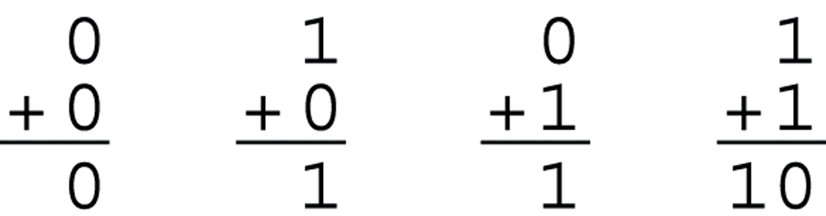
Figure 1.17 The Binary Addition Facts（法则）

Slide 39
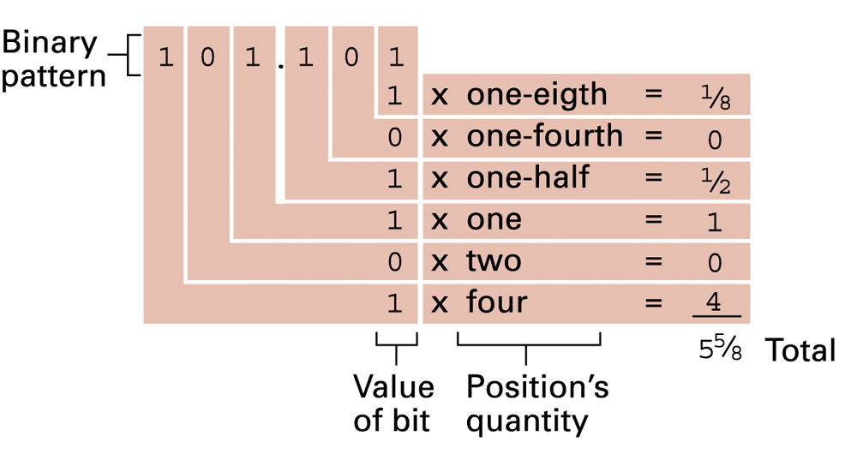
Figure 1.18 Decoding（解码） the Binary Representation 101.101

Slide 40
Storing Integers
Two’s complement notation（二补记数法）: The most popular means of representing integer values
Excess notation（余码计数法）: Another means of representing integer values
Both can suffer from overflow（溢出） errors

Slide 41
Figure 1.19 Two’s Complement（补码） Notation （记数法）Systems
Using patterns of length three
长度为3的位模式
b. Using patterns of length four
Bit pattern | Value represented
0111 | 7
0110 | 6
0101 | 5
0100 | 4
0011 | 3
0010 | 2
0001 | 1
0000 | 0
1111 | −1
1110 | −2
1101 | −3
1100 | −4
1011 | −5
1010 | −6
1001 | −7
1000 | −8
Bit pattern | Value represented
011 | 3
010 | 2
001 | 1
000 | 0
111 | −1
110 | −2
101 | −3
100 | −4

Slide 42
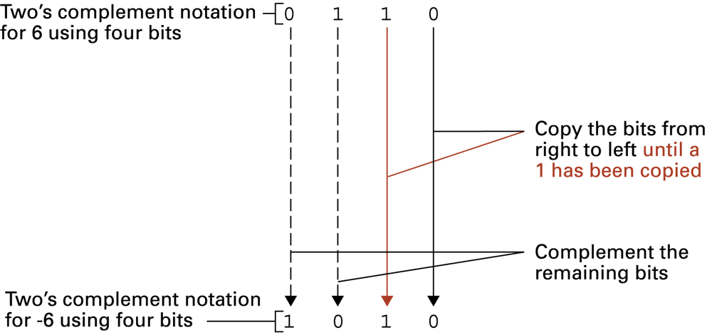
Figure 1.20 Coding the Value -6 in Two‘s Complement Notation Using Four Bits 用四位二进制补码记数法对6进行编码
用四位二进制补码

Slide 43
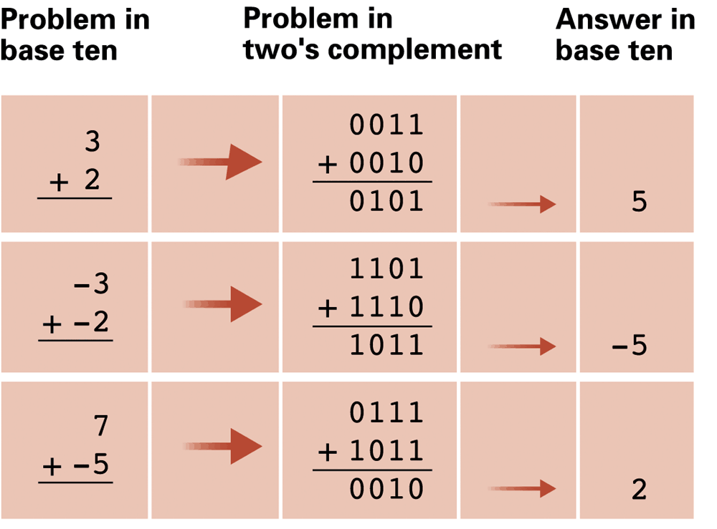
Figure 1.21 Addition Problems Converted to Two’s Complement Notation（转换成二进制补码的加法问题,都用补码形式就可以避免：减法=加上一个负数）

Slide 44
Figure 1.22 An Excess Eight Conversion Table（余8代码转换表，跟二进制补码系统的区别就是符号位相反）
Bit pattern | Value represented
1111 | 7
1110 | 6
1101 | 5
1100 | 4
1011 | 3
1010 | 2
1001 | 1
1000 | 0
0111 | −1
0110 | −2
0101 | −3
0100 | −4
0011 | −5
0010 | −6
0001 | −7
0000 | −8

Slide 45
Figure 1.23 An Excess Notation System（余码记数系统） Using Bit Patterns of Length Three
Bit pattern | Value represented
111 | 3
110 | 2
101 | 1
100 | 0
011 | −1
010 | −2
001 | −3
000 | −4

Slide 46
Storing Fractions（小数）
Floating-point Notation: Consists of a sign bit, a mantissa（尾数域） field, and an exponent field（指数域）.
Related topics include
Normalized form（规范化形式）(从二进制表示最左边的1开始填充尾数域)
Truncation errors （ trʌŋˈkeɪʃn 截断）

Slide 47
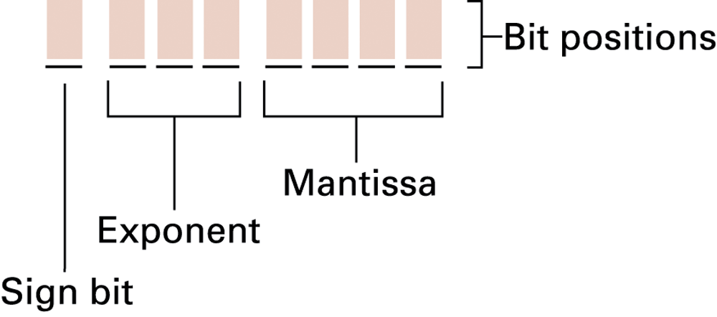
Figure 1.24 Floating-Point Notation Components（成分）

Slide 48
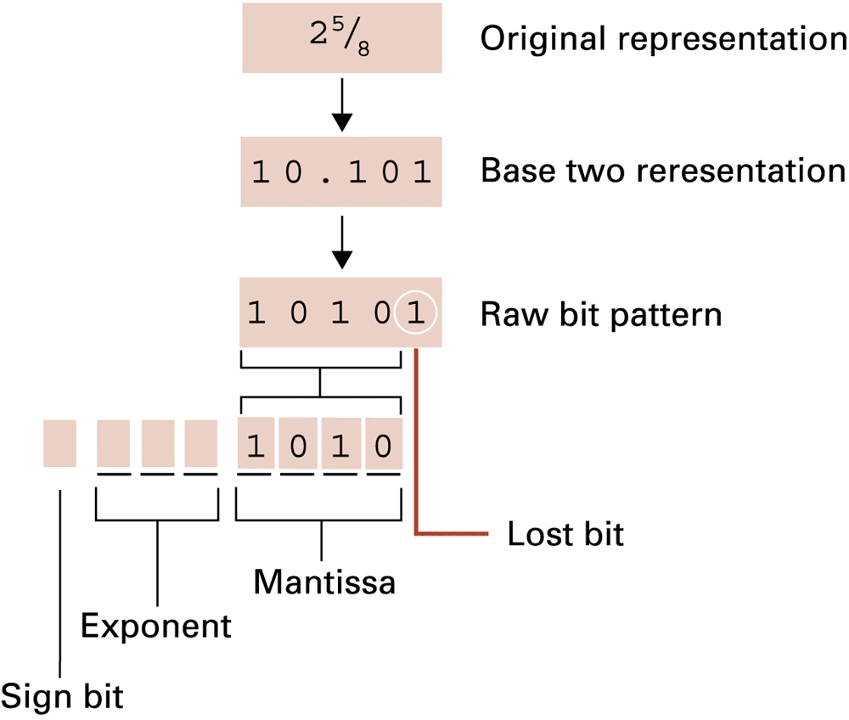
Figure 1.25 Encoding the Value
原始位模式
尾数
指数

Slide 49
Data and Programing
A programming language is a computer system created to allow humans to precisely express algorithms using a higher level of abstraction.

Slide 50

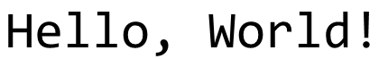
Getting Started with Python
Python: a popular programming language for applications, scientific computation, and as an introductory language for students
Freely available from www.python.org
Python is an interpreted language（解释型的语言）
Typing:
Results in:

Slide 51
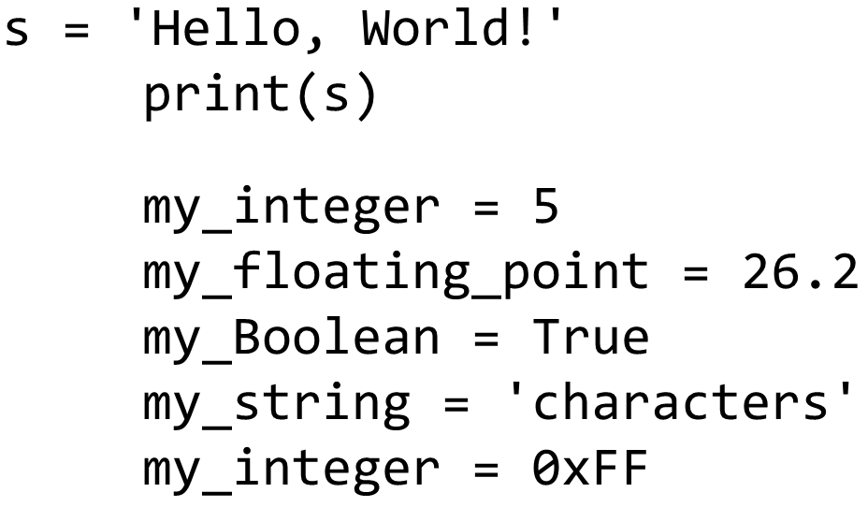
Variables
Variables: name values for later use
Analogous to mathematic variables in algebra

Slide 52
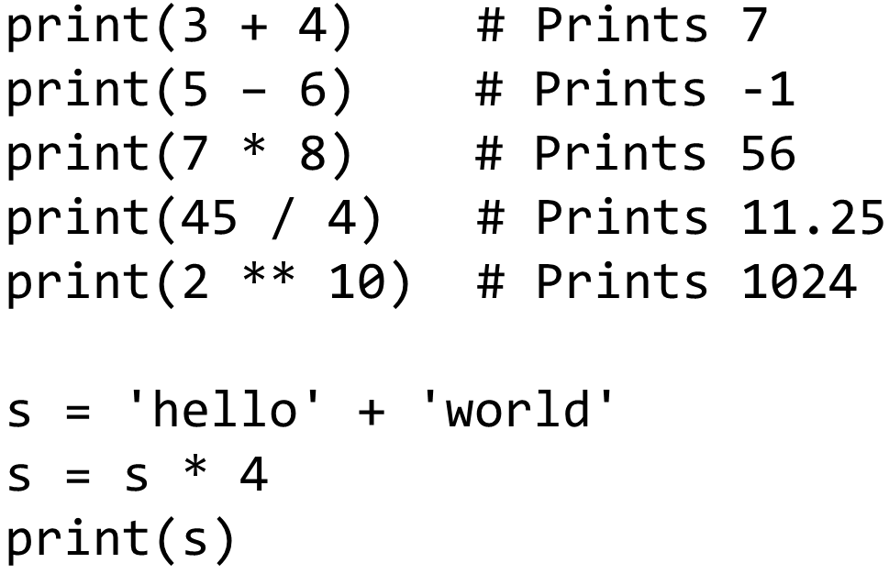
Operators and Expressions

Slide 53
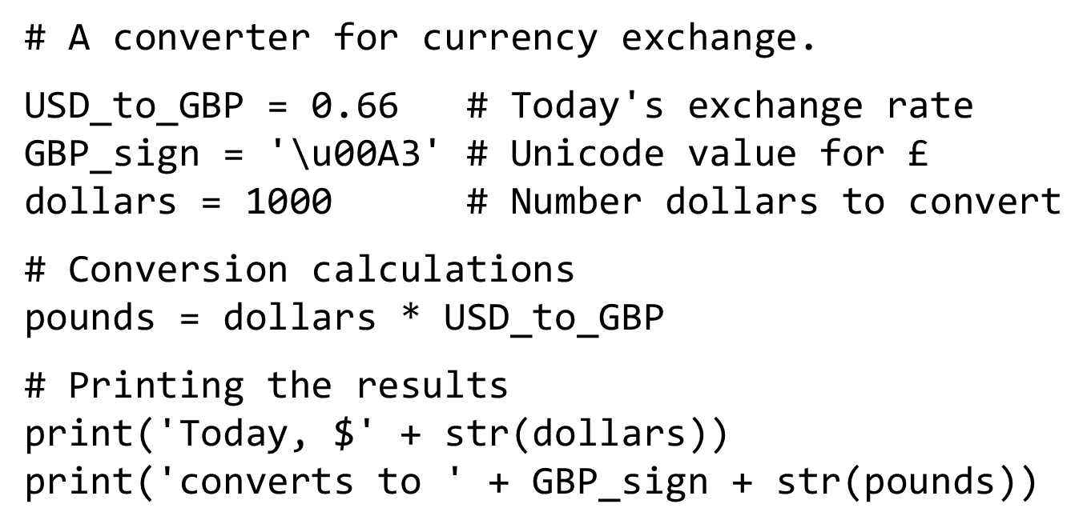
Currency Conversion（货币转换）

Slide 54
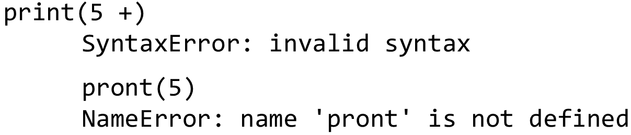
Debugging（调试）
Syntax errors（语法错误）
Semantic（语义） errors
Incorrect expressions like
Runtime errors（运行时错误）
Unintentional divide by zero

Slide 55
Data Compression
Lossy versus lossless
Run-length encoding
Frequency-dependent encoding (Huffman codes)
Relative encoding
Dictionary encoding (Includes adaptive dictionary encoding such as L Z W encoding.)

Slide 56
Compressing Images
G I F: Good for cartoons
J P E G: Good for photographs
T I F F: Good for image archiving

Slide 57
Compressing Audio and Video
M P E G
High definition television broadcast
Video conferencing
M P3
Temporal masking
Frequency masking

Slide 58
Communication Errors
Parity bits (even versus odd)
Checkbytes
Error correcting codes

Slide 59
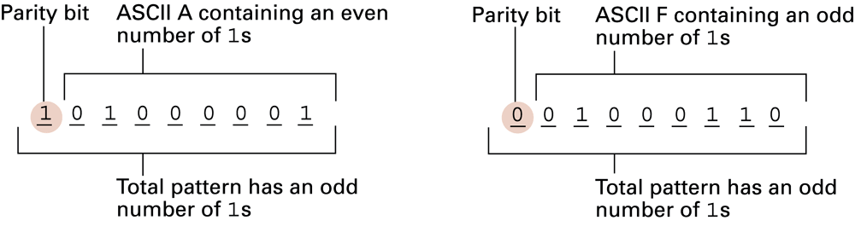
Figure 1.26 The A S C I I Codes for the Letters A and F Adjusted for Odd Parity

Slide 60
Figure 1.27 An Error-Correcting Code
Symbol | Code
A | 000000
B | 001111
C | 010011
D | 011100
E | 100110
F | 101001
G | 110101
H | 111010

Slide 61
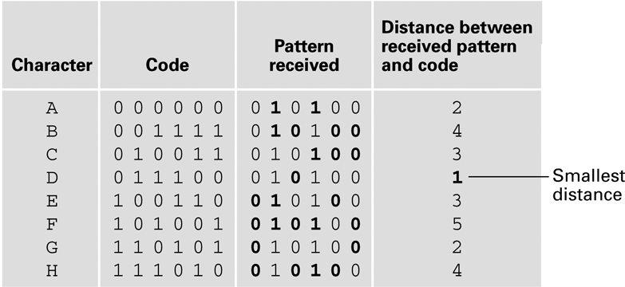
Figure 1.28 Decoding the Pattern 010100 Using the Code in Figure 1.27

